Slide 1

Bangladesh Army University of Science and Technology (BAUST), Saidpur
Department of Computer Science and Engineering
CSE 4000: Project and Thesis
Exploring Advanced Models for Time Series-Based Weather Forecasting in Bangladesh: A Comparative Analysis of ARIMA, SARIMA, FbProphet, LSTM, and BiLSTM Models.
Presented By:
Most. Jannat-Ul Fredoush (200101068)
Mst. Habiba Hena Sumi (200101070)
Md. Talath Un Nabi (200101076)
Supervised By:
Md. Mamun Hossain
Assistant Professor
Bangladesh Army University of Science and Technology (BAUST), Saidpur

Slide 2

Outline
Introduction
Literature Review
Problem Statement
Objectives
Dataset Description
Methodology
Results and Outcomes
Social Impact and Benefit
Conclusion
Future Works
Limitations
References
Exploring Advanced Models for Time Series-Based Weather Forecasting in Bangladesh: A Comparative Analysis of ARIMA, SARIMA, FbProphet, LSTM, and BiLSTM Models.

Slide 3
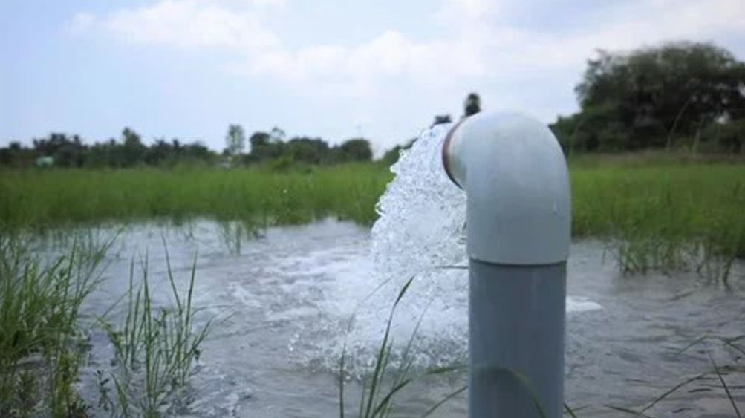
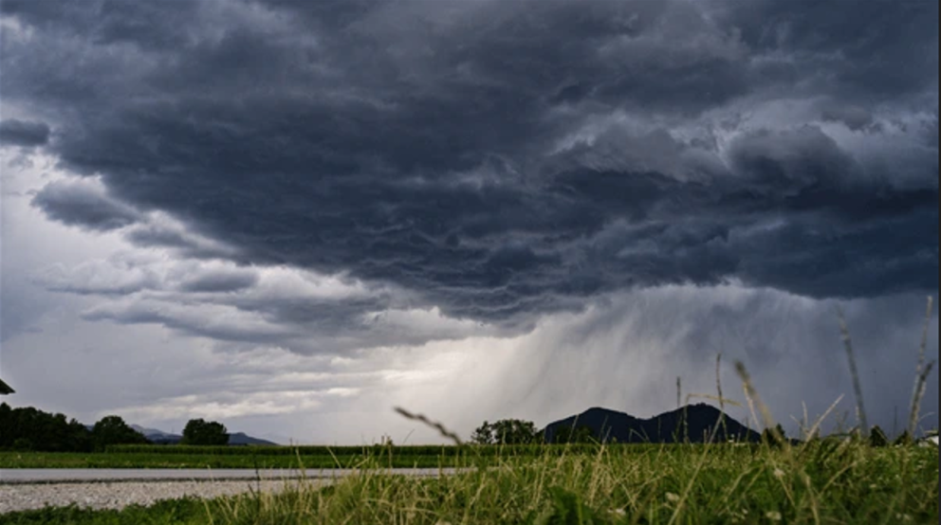

Introduction
Future weather predictions, driven by advancements in temperature forecasting, empower us to anticipate and adapt to changing climatic conditions, aiding diverse sectors from agriculture to infrastructure planning.
Integrating temperature and rain predictions provides a comprehensive outlook, facilitating informed decision-making to mitigate the impact of weather events on various aspects of our daily lives(agriculture to industry, from traveling to daily commuting)
Exploring Advanced Models for Time Series-Based Weather Forecasting in Bangladesh: A Comparative Analysis of ARIMA, SARIMA, FbProphet, LSTM, and BiLSTM Models.

Slide 4
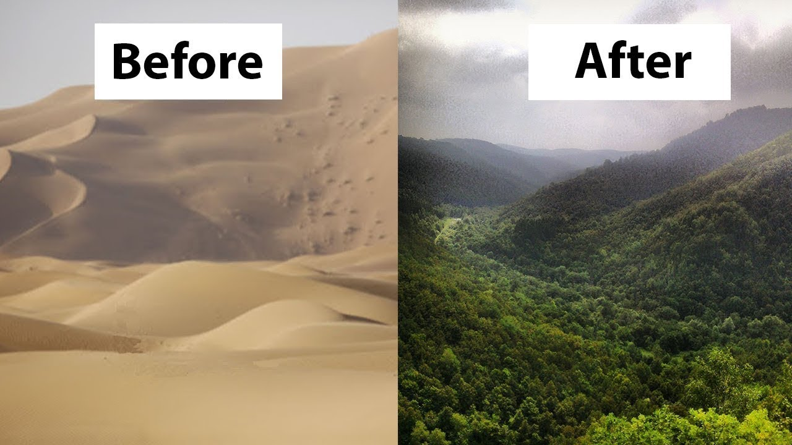
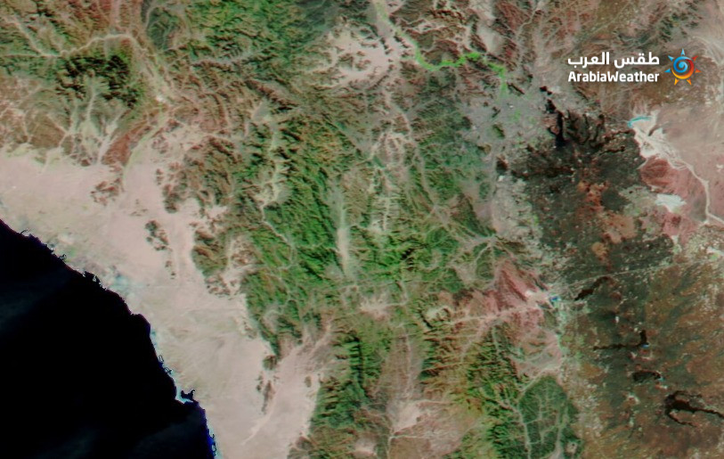
Introduction
Figure: Saudi Arabia turning green
The transformation of desert regions into lush green places, such as Saudi Arabia, is indicative of changing climate trends.
Exploring Advanced Models for Time Series-Based Weather Forecasting in Bangladesh: A Comparative Analysis of ARIMA, SARIMA, FbProphet, LSTM, and BiLSTM Models.

Slide 5
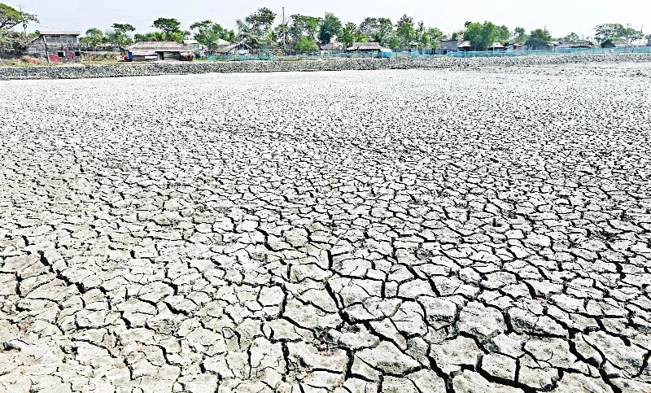
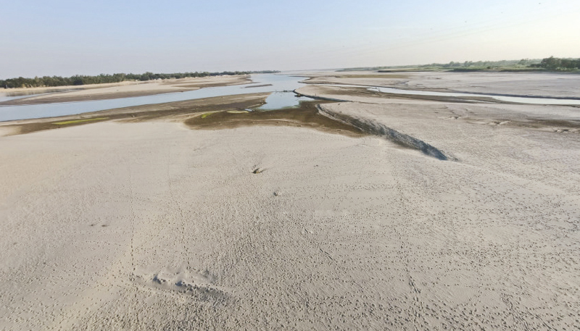
Introduction
Figure: Bangladesh turning into desert
As Bangladesh suffers desertification, accurate weather forecasting is critical. Accurate projections are critical in directing adaptation strategies and reducing the negative impacts on agricultural and water resources, underscoring their critical importance.
Exploring Advanced Models for Time Series-Based Weather Forecasting in Bangladesh: A Comparative Analysis of ARIMA, SARIMA, FbProphet, LSTM, and BiLSTM Models.

Slide 6
Application
Optimized Agriculture Planning
Efficient Water Resource Management
Enhanced Public Health Planning
Resilient Infrastructure Design
Travel Planning
Effective Disaster Preparedness
Exploring Advanced Models for Time Series-Based Weather Forecasting in Bangladesh: A Comparative Analysis of ARIMA, SARIMA, FbProphet, LSTM, and BiLSTM Models.

Slide 7
Literature Review
Author | Title | Year | Work | Algorithm | Loss
 |  |  |  |  | MSE | RMSE | MAE
Badal, Md Khirul Islam and Saha, Sajeeb[1] | Performance Analysis of Deep Neural Network Models for Weather Forecasting in Bangladesh | 2022 | Temperature Forecasting | ARIMA | 0.541 | 0.763 | 0.597
 |  |  |  | BiLSTM | 0.414 | 0.584 | 0.483
Khan, Mohammad Mahmudur Rahman and Siddique, Md Abu Bakr and Sakib, Shadman and Aziz, Anas and Tasawar, Ihtyaz Kader and Hossain, Ziad[2] | Analysis and Predictions of Seasonal Affected Weather Variables of Bangladesh: SARIMA Models vs. Traditional Models | 2018 | Temperature, Rainfall, Humidity Forecasting | SARIMA |  | 0.7021 | 0.5325
[1] Badal, Md Khirul Islam, and Sajeeb Saha. "Performance analysis of deep neural network models for weather forecasting in bangladesh." Proceedings of the Third International Conference on Trends in Computational and Cognitive Engineering: TCCE 2021. Singapore: Springer Nature Singapore, 2022.
[2] Khan, Md Salauddin, et al. "Analysis and Predictions of Seasonal Affected Weather Variables of Bangladesh: SARIMA Models vs. Traditional Models." International Journal of Business and Management 13.11 (2018).
Exploring Advanced Models for Time Series-Based Weather Forecasting in Bangladesh: A Comparative Analysis of ARIMA, SARIMA, FbProphet, LSTM, and BiLSTM Models.

Slide 8
Literature Review
Author | Title | Year | Work | Algorithm | Loss
 |  |  |  |  | MSE | RMSE | MAE | MAPE
Nury, AH and Koch, M and Alam, MJB[3] | Time series analysis and forecasting of temperatures in the sylhet division of bangladesh | 2013 | Temperature Forecasting | SARIMA |  | .949 | .716 | 2.378
Ray, Soumik and Das, Soumitra Sankar and Mishra, Pradeep and Al Khatib, Abdullah Mohammad Ghazi[4] | Time Series SARIMA Modelling and Forecasting of Monthly Rainfall and Temperature in the South Asian Countries. | 2021 | Temperature, Humidity and Rainfall Forecasting | ARIMA |  | 1.004363 | 1.003992
 |  |  |  |  |  | 35.86249 | 4.3396
[3]Nury, A. H., M. Koch, and M. J. B. Alam. "Time series analysis and forecasting of temperatures in the sylhet division of bangladesh." 4th International Conference on Environmental Aspects of Bangladesh (ICEAB), August. 2013.
[4] Ray, Soumik, et al. "Time series SARIMA modelling and forecasting of monthly rainfall and temperature in the South Asian countries." Earth Systems and Environment 5 (2021): 531-546.
Exploring Advanced Models for Time Series-Based Weather Forecasting in Bangladesh: A Comparative Analysis of ARIMA, SARIMA, FbProphet, LSTM, and BiLSTM Models.

Slide 9
Literature Review
Author | Title | Year | Work | Algorithm | Loss
 |  |  |  |  | MSE | RMSE | MAE | MAPE
Toharudin, Toni and Pontoh, Resa Septiani and Caraka, Rezzy Eko and Zahroh, Solichatus and Lee, Youngjo and Chen, Rung Ching[5] | Employing long short-term memory and Facebook prophet model in air temperature forecasting | 2023 | Temperature Forecasting | LSTM |  | 1.23
 |  |  |  | Prophet |  | 1.03
Balaji, N and Bhandary, Shreejan B and Dsouza, Rodney Francis and Pai, Bh Karthik[6] | ANN Based Weather Analysis and Prediction | 2022 | Predict Future Weather | BiLSTM |  | 1.9283 | 1.3749
[5] Toharudin, Toni, et al. "Employing long short-term memory and Facebook prophet model in air temperature forecasting." Communications in Statistics-Simulation and Computation 52.2 (2023): 279-290.
[6] Balaji, N., et al. "ANN Based Weather Analysis and Prediction." 2022 International Conference on Distributed Computing, VLSI, Electrical Circuits and Robotics (DISCOVER). IEEE, 2022.
Exploring Advanced Models for Time Series-Based Weather Forecasting in Bangladesh: A Comparative Analysis of ARIMA, SARIMA, FbProphet, LSTM, and BiLSTM Models.

Slide 10
Literature Review
Author | Title | Year | Work | Algorithm | Loss
 |  |  |  |  | MSE | RMSE | MAE | MAPE
Lama, Achal and Singh, KN and Singh, Herojit and Shekhawat, Ravindra and Mishra[7] | Forecasting monthly rainfall of Sub‑Himalayan region of India using parametric and non‑parametric modelling approaches | 2021 | Rainfall | SARIMA |  | 83.81 |  | 39.27
Bedi, Jatin and Toshniwal, Durga[8] | A Hybrid Time Series Rainfall Prediction Model Using Neural Prophet and LS TM | 2023 | Rainfall | LSTM + NP |  | 0.25 | 0.16
[7]Lama, Achal, et al. "Forecasting monthly rainfall of Sub-Himalayan region of India using parametric and non-parametric modelling approaches." Modeling Earth Systems and Environment (2021): 1-9.
[8]G. L. V. Prasad, B. R. Teja, T. Haribabu, G. N. Pavani, D. Karunamma and K. Vivek, "A Hybrid Time Series Rainfall Prediction Model Using Neural Prophet and LS TM," 2023 International Conference on Self Sustainable Artificial Intelligence Systems (ICSSAS), Erode, India, 2023, pp. 1582-1587, doi: 10.1109/ICSSAS57918.2023.10331827.
Exploring Advanced Models for Time Series-Based Weather Forecasting in Bangladesh: A Comparative Analysis of ARIMA, SARIMA, FbProphet, LSTM, and BiLSTM Models.

Slide 11
Problem Statement
The purpose is to create a comprehensive weather forecasting model that uses deep learning and time series approaches to improve prediction accuracy, allowing for better decision-making and resource management in the face of more unexpected and extreme weather events.
Exploring Advanced Models for Time Series-Based Weather Forecasting in Bangladesh: A Comparative Analysis of ARIMA, SARIMA, FbProphet, LSTM, and BiLSTM Models.

Slide 12
Objectives
To collect up to date historical weather data of Bangladesh.
To apply Time Series and Deep Learning models(ARIMA, SARIMA, Prophet, LSTM, BiLSTM) to capture comprehensive patterns in weather conditions.
To predict future trend & weather of Bangladesh to uncover latent hierarchical patterns in the weather dataset for a deeper understanding.
To enhance/optimize performance through advanced modeling and observational techniques in terms of MSE, RMSE, MAE, MAPE.
To inform government about our research findings.
Exploring Advanced Models for Time Series-Based Weather Forecasting in Bangladesh: A Comparative Analysis of ARIMA, SARIMA, FbProphet, LSTM, and BiLSTM Models.

Slide 13
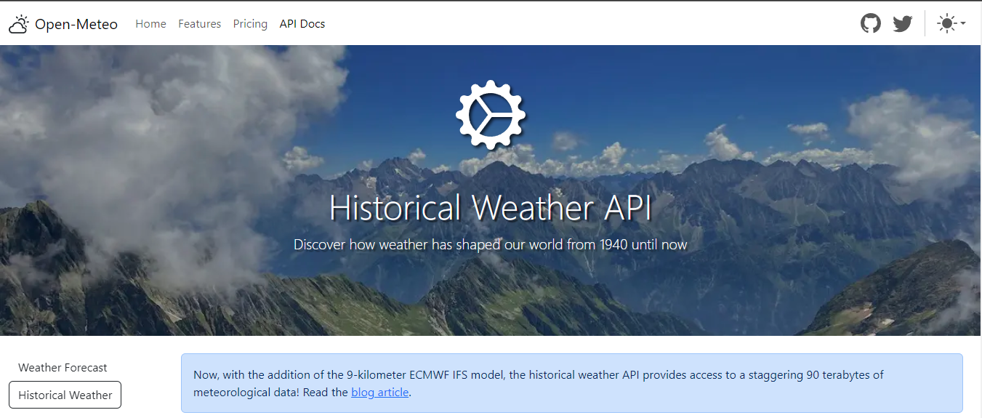
Dataset
Data Source Link: https://open-meteo.com/en/docs/historical-weather-api
Exploring Advanced Models for Time Series-Based Weather Forecasting in Bangladesh: A Comparative Analysis of ARIMA, SARIMA, FbProphet, LSTM, and BiLSTM Models.

Slide 14
Dataset: Features
Total features: 14
Total unique values: 5735
Dominant Features:
time
rain_sum (mm)
temperature_mean(°C)
List of Features:
time
weathercode (wmo code)
temperature_2m_max (Â°C)
temperature_2m_min (Â°C)
temperature_2m_mean (Â°C)
sunrise (iso8601)
sunset (iso8601)
precipitation_sum (mm)
rain_sum (mm)
snowfall_sum (cm)
windspeed_10m_max (mp/h)
windgusts_10m_max (mp/h)
winddirection_10m_dominant (Â°)
shortwave_radiation_sum (MJ/mÂ²)
Exploring Advanced Models for Time Series-Based Weather Forecasting in Bangladesh: A Comparative Analysis of ARIMA, SARIMA, FbProphet, LSTM, and BiLSTM Models.

Slide 15
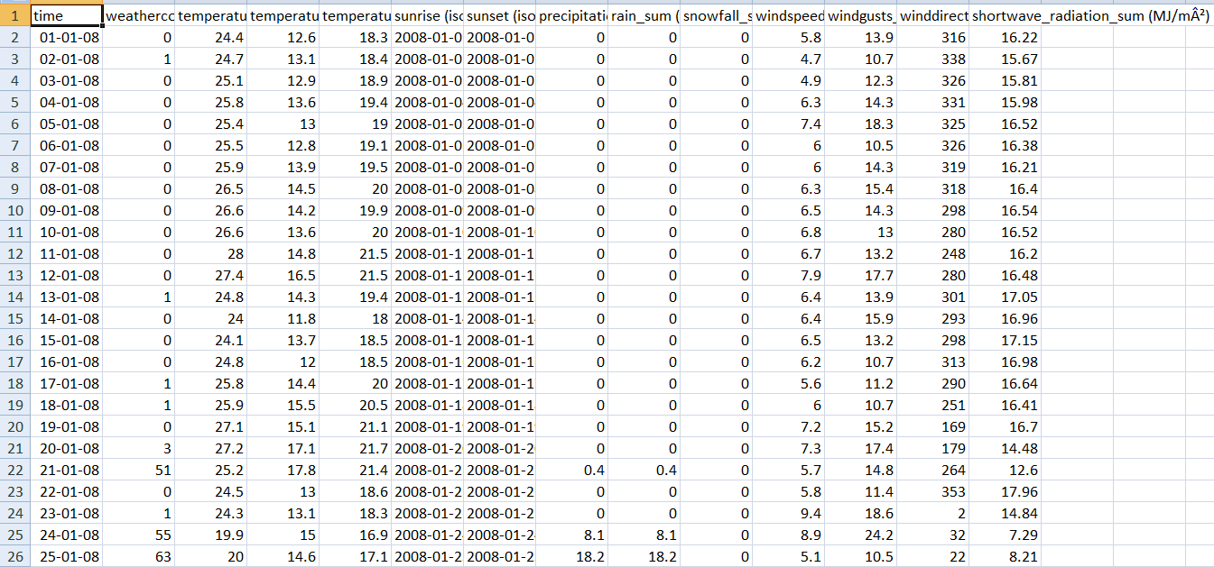
Dataset
Dataset: Bangladesh Historical Weather Dataset 2008-2023
Exploring Advanced Models for Time Series-Based Weather Forecasting in Bangladesh: A Comparative Analysis of ARIMA, SARIMA, FbProphet, LSTM, and BiLSTM Models.

Slide 16
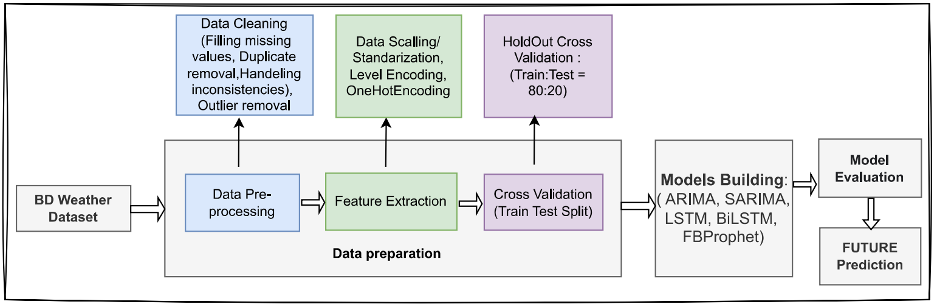
Methodology : Design
Figure: Flow Chart of Proposed Weather Forecasting System
Exploring Advanced Models for Time Series-Based Weather Forecasting in Bangladesh: A Comparative Analysis of ARIMA, SARIMA, FbProphet, LSTM, and BiLSTM Models.

Slide 17
Methodology : Description
Data Collection: We collected the dataset from the Open-Meteo website.
Data Preparation:
Handle Missing Values: Identify and drop missing values.
Reshape Data: Adjust the data to a range between -1 and 1.
Data Scaling: Applied MinMaxScaler with a feature range of 0 to 1.
Train-Test Split: The total dataset consists of 5735 data points. We divided the data into 80% for training (4586 data points) and 20% for testing (1149 data points).
Models for Training: We used ARIMA, SARIMA, Prophet, LSTM, and Bi-LSTM models for training.
Model Evaluation: Calculated Mean Squared Error (MSE), Root Mean Squared Error (RMSE), Mean Absolute Error (MAE), and Mean Absolute Percentage Error (MAPE) to evaluate the performance of our models.
Forecast: Predicted Future Weather for the Next 365 Days.
Exploring Advanced Models for Time Series-Based Weather Forecasting in Bangladesh: A Comparative Analysis of ARIMA, SARIMA, FbProphet, LSTM, and BiLSTM Models.

Slide 18
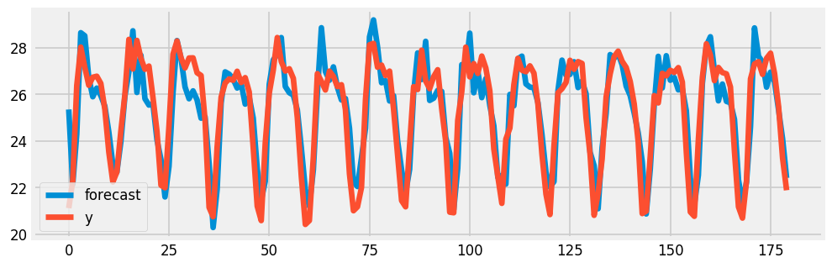
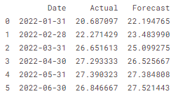
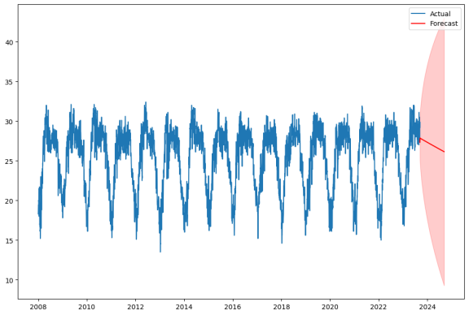
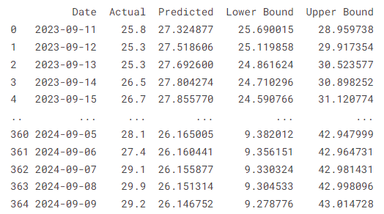
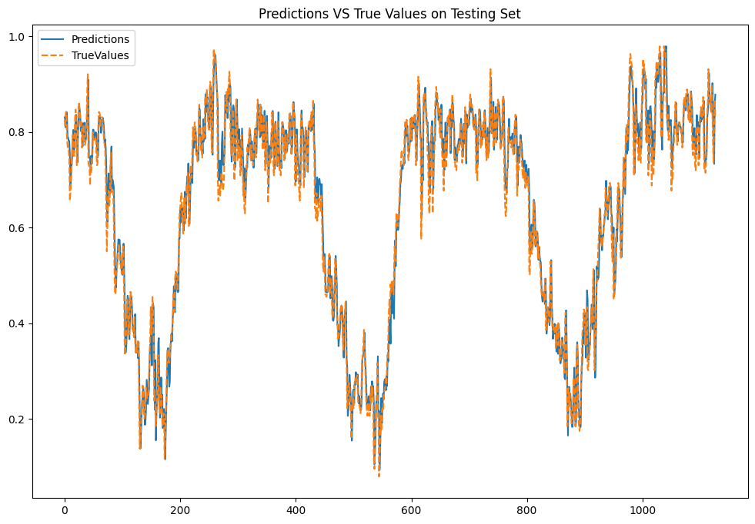
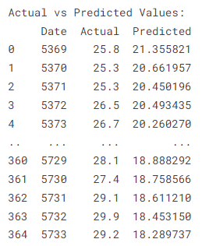
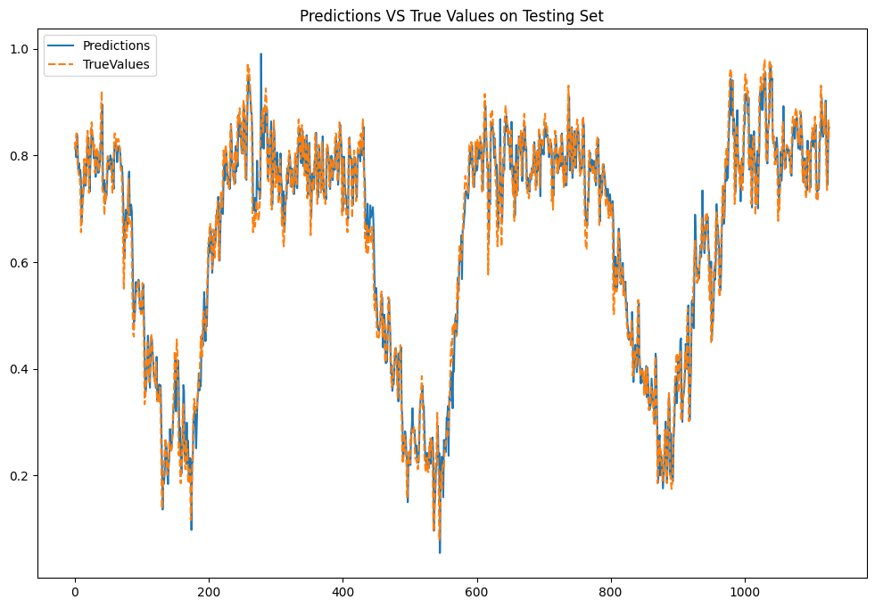
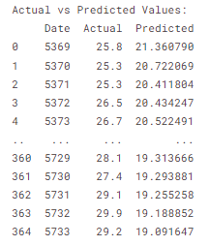
Result on Temperature: Actual vs Predicted
1. ARIMA
2. SARIMA
3. LSTM
4. Bi-LSTM
Exploring Advanced Models for Time Series-Based Weather Forecasting in Bangladesh: A Comparative Analysis of ARIMA, SARIMA, FbProphet, LSTM, and BiLSTM Models.

Slide 19
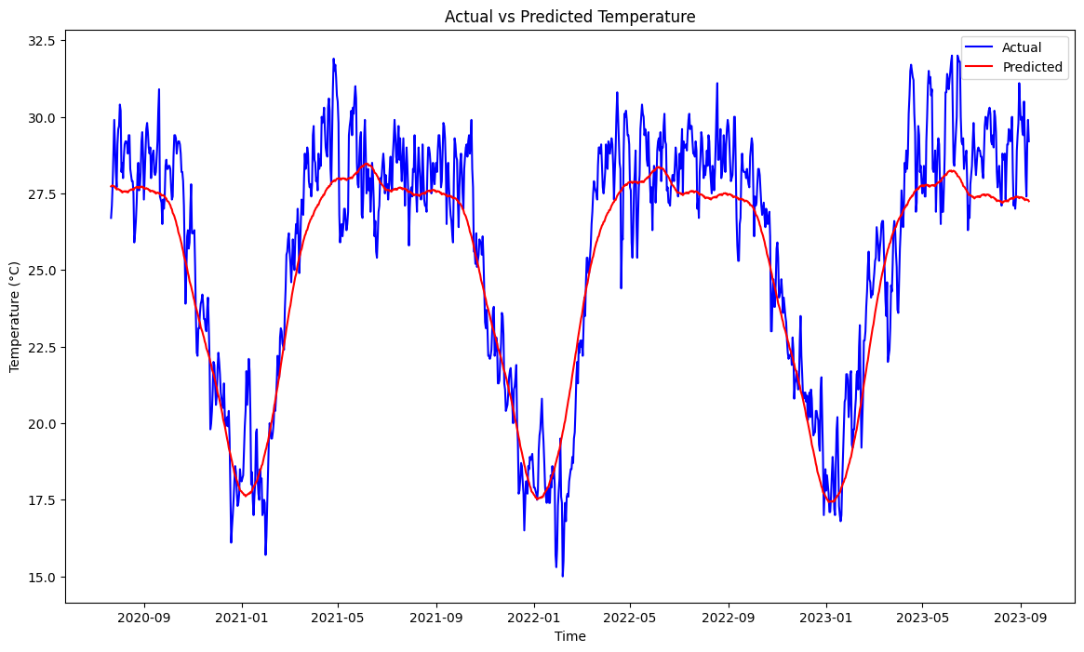
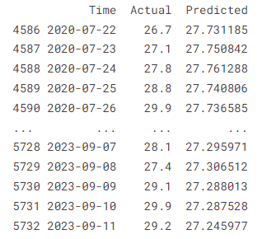
Result on Temperature: Actual vs Predicted
5. Prophet
By examining the Actual vs Predicted curves of the five models, it can be understood that the Actual and Predicted values of Prophet model are very similar for Temperature data.
Exploring Advanced Models for Time Series-Based Weather Forecasting in Bangladesh: A Comparative Analysis of ARIMA, SARIMA, FbProphet, LSTM, and BiLSTM Models.

Slide 20
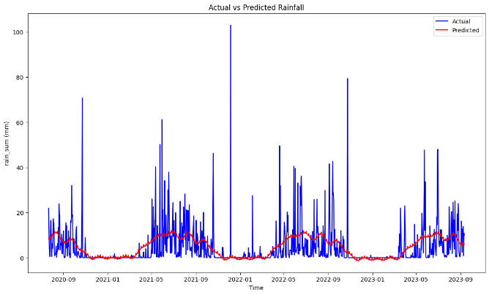
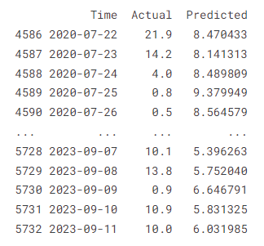
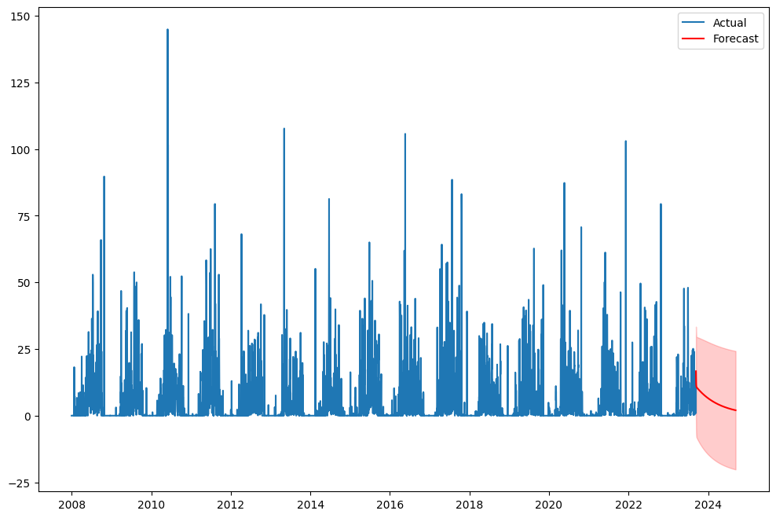
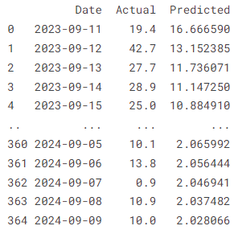
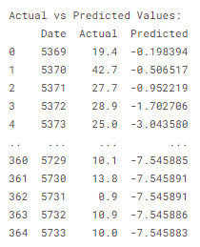
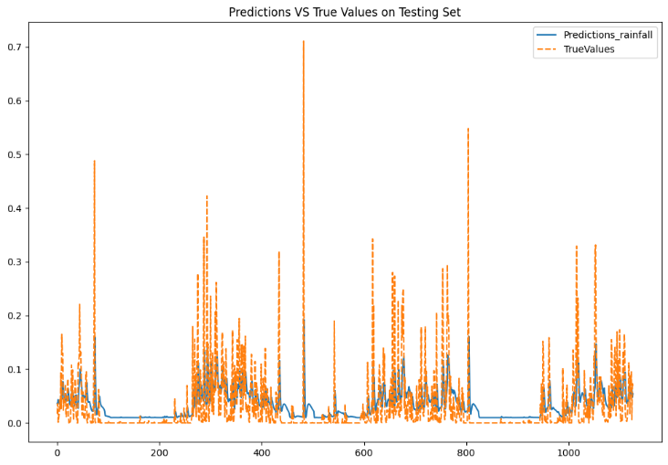
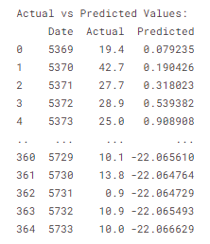
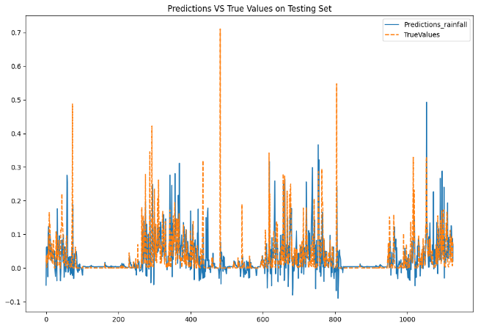
Result on Rainfall: Actual vs Predicted
1. Prophet
2. SARIMA
3. LSTM
4. Bi-LSTM
Exploring Advanced Models for Time Series-Based Weather Forecasting in Bangladesh: A Comparative Analysis of ARIMA, SARIMA, FbProphet, LSTM, and BiLSTM Models.

Slide 21
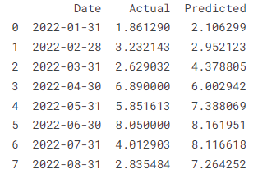
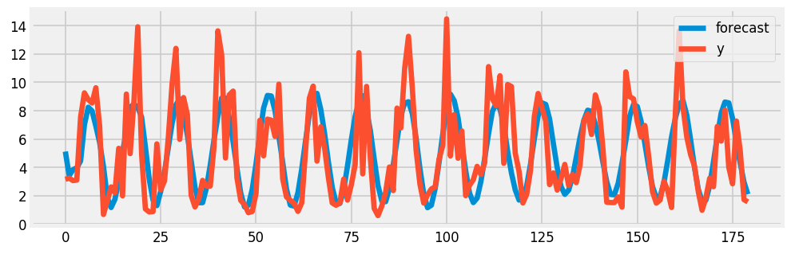
Result on Rainfall: Actual vs Predicted
5. ARIMA
By examining the Actual vs Predicted curves of the five models, it can be understood that the Actual and Predicted values of ARIMA model are very similar for Rainfall data.
Exploring Advanced Models for Time Series-Based Weather Forecasting in Bangladesh: A Comparative Analysis of ARIMA, SARIMA, FbProphet, LSTM, and BiLSTM Models.

Slide 22
Result
Models | LOSS
 | Temperature |  |  | Rainfall
 | MSE | RMSE | MAE | MSE | RMSE | MAE
ARIMA | 2.970 | 1.723 | 1.553 | 4.498 | 2.120 | 1.559
SARIMA | 19.903 | 4.461 | 3.742 | 93.079 | 9.647 | 5.070
PROPHET | 2.509 | 1.584 | 1.284 | 68.965 | 8.304 | 4.612
LSTM | 0.00169 | 0.04116 | 0.03105 | 0.00453 | 0.06731 | 0.03558
Bi-LSTM | 0.00181 | 0.04261 | 0.03228 | 0.00468 | 0.06843 | 0.03721
We can see from above table LSTM has lower MSE loss.
Exploring Advanced Models for Time Series-Based Weather Forecasting in Bangladesh: A Comparative Analysis of ARIMA, SARIMA, FbProphet, LSTM, and BiLSTM Models.

Slide 23
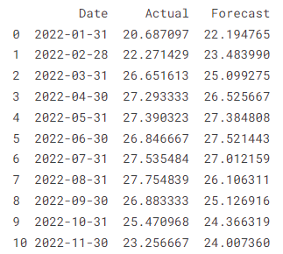

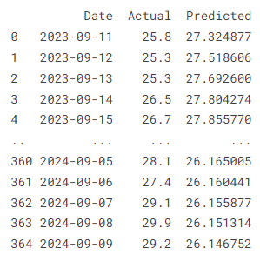
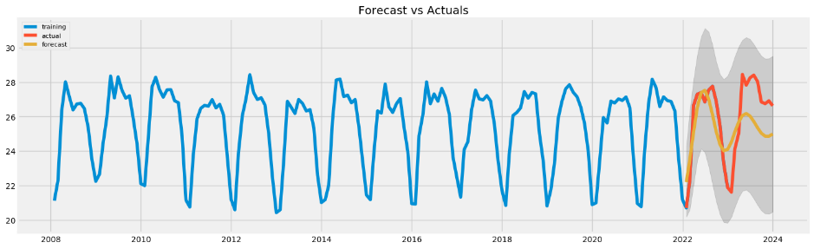
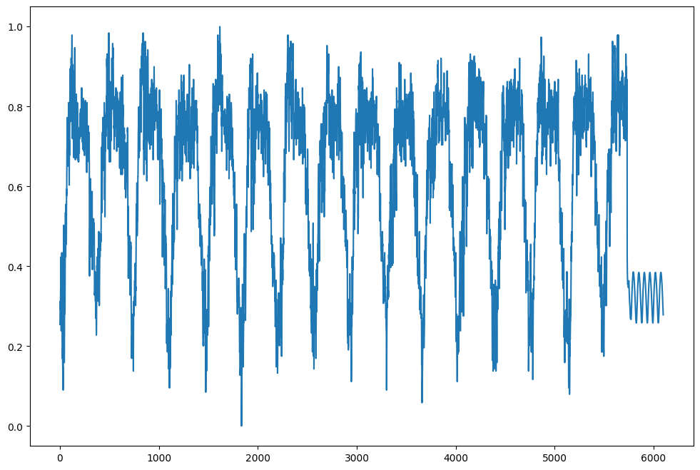
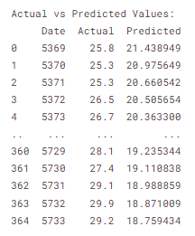
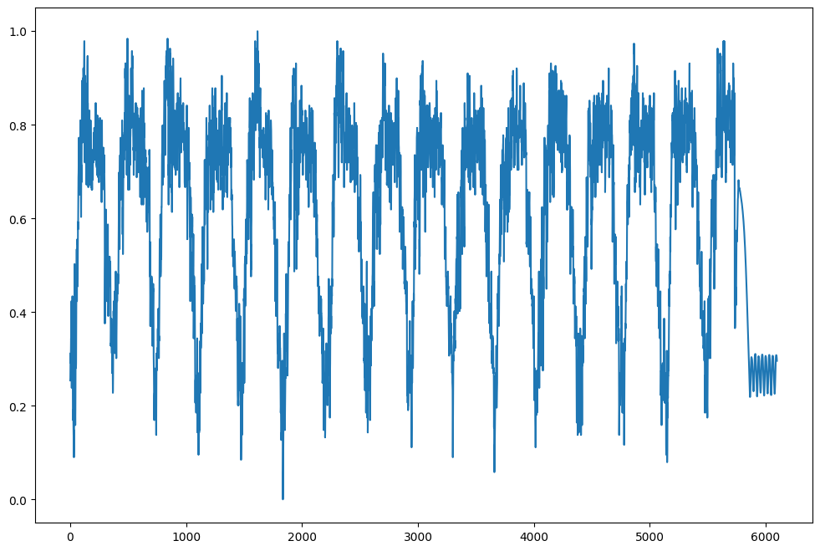
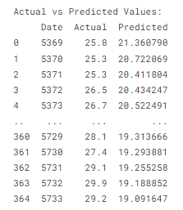
Result on Temperature: Forecasting
1. ARIMA
2. SARIMA
3. LSTM
4. Bi-LSTM
Exploring Advanced Models for Time Series-Based Weather Forecasting in Bangladesh: A Comparative Analysis of ARIMA, SARIMA, FbProphet, LSTM, and BiLSTM Models.

Slide 24
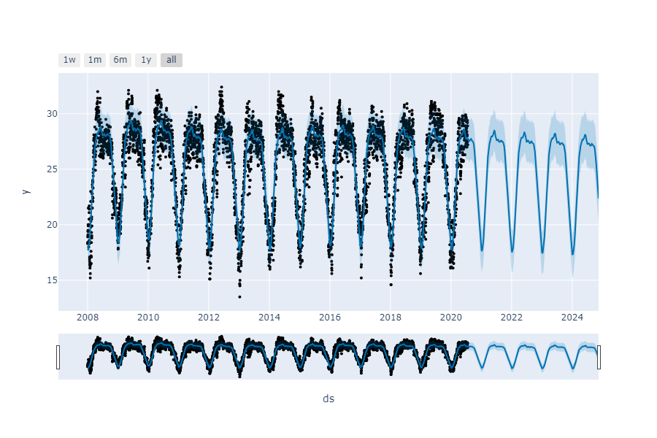
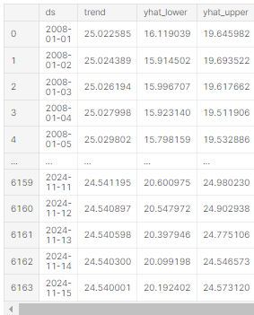
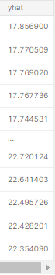
Result on Temperature: Forecasting
Forecasted
5. Prophet
Exploring Advanced Models for Time Series-Based Weather Forecasting in Bangladesh: A Comparative Analysis of ARIMA, SARIMA, FbProphet, LSTM, and BiLSTM Models.

Slide 25
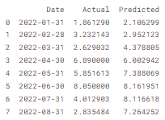
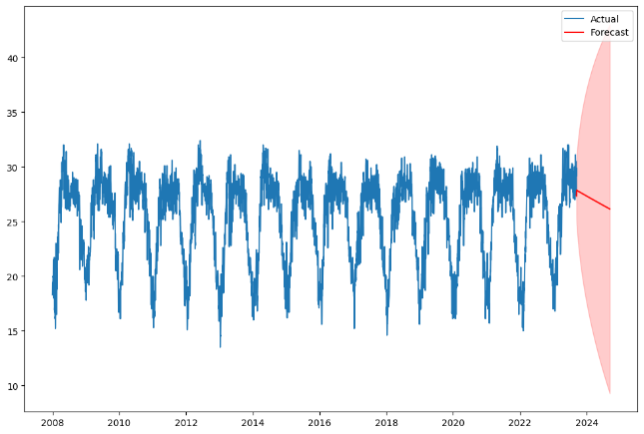
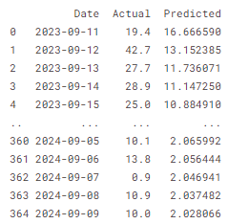
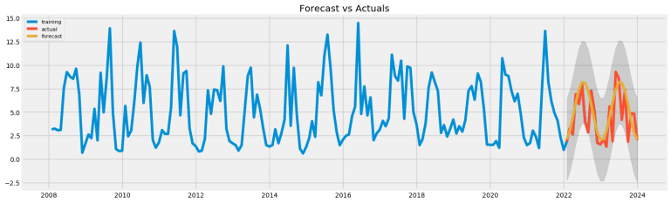
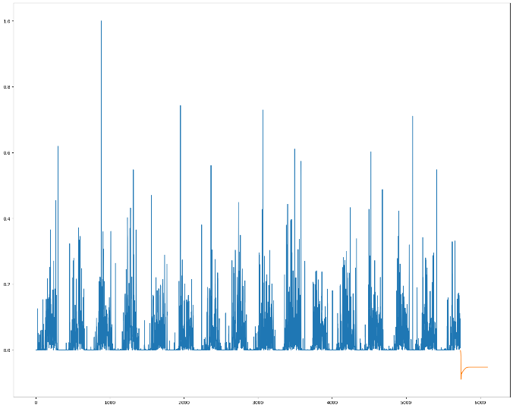
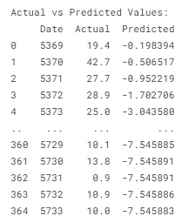
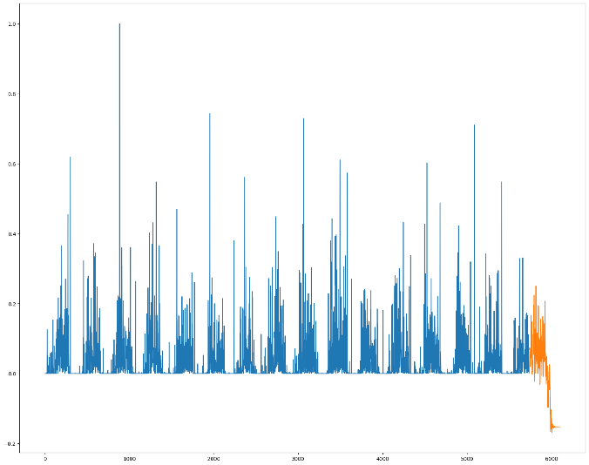
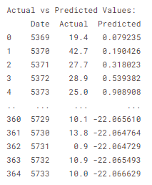
Result on Rainfall: Forecasting
1. ARIMA
2. SARIMA
3. LSTM
4. Bi-LSTM
Exploring Advanced Models for Time Series-Based Weather Forecasting in Bangladesh: A Comparative Analysis of ARIMA, SARIMA, FbProphet, LSTM, and BiLSTM Models.

Slide 26
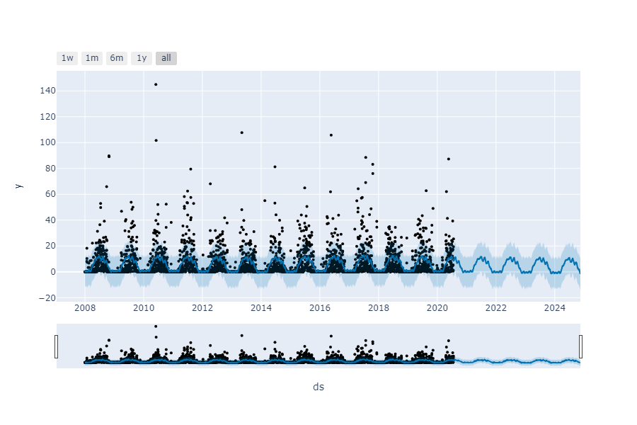
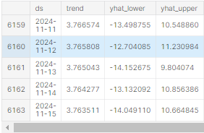
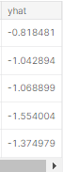
Result on Rainfall: Forecasting
Forecasted
5. Prophet
Exploring Advanced Models for Time Series-Based Weather Forecasting in Bangladesh: A Comparative Analysis of ARIMA, SARIMA, FbProphet, LSTM, and BiLSTM Models.

Slide 27
Global Comparison Table
Author | Model | Loss
 |  | Temperature |  |  | Rainfall
 |  | MSE | RMSE | MAE | MSE | RMSE | MAE
Nury, AH and Koch, M and Alam, MJB[3] | ARIMA | 0.541 | 0.763 | 0.597
 | SARIMA | 0.414 | 0.584 | 0.483
Khan, Mohammad Mahmudur Rahman and Siddique, Md Abu Bakr and Sakib, Shadman and Aziz, Anas and Tasawar, Ihtyaz Kader and Hossain, Ziad[2] | SARIMA | 0.7021 | 0.5325 | 0.7287 | 70.6504 | 49.4503 | 0.7121
Ray, Soumik and Das, Soumitra Sankar and Mishra, Pradeep and Al Khatib, Abdullah Mohammad Ghazi[4] | ARIMA |  | 1.004363 | 1.003992 |  | 35.86249 | 4.3396
Toharudin, Toni and Pontoh, Resa Septiani and Caraka, Rezzy Eko and Zahroh, Solichatus and Lee, Youngjo and Chen, Rung Ching[5] | LSTM |  | 1.23
 | PROPHET |  | 1.03
Proposed Method | ARIMA | 2.970 | 1.723 | 1.553 | 4.498 | 2.120 | 1.559
 | SARIMA | 19.903 | 4.461 | 3.742 | 93.079 | 9.647 | 5.070
 | PROPHET | 2.509 | 1.584 | 1.284 | 68.965 | 8.304 | 4.612
 | LSTM | 0.00169 | 0.04116 | 0.03105 | 0.00453 | 0.06731 | 0.03558
 | Bi-LSTM | 0.00181 | 0.04261 | 0.03228 | 0.00468 | 0.06843 | 0.03721
Exploring Advanced Models for Time Series-Based Weather Forecasting in Bangladesh: A Comparative Analysis of ARIMA, SARIMA, FbProphet, LSTM, and BiLSTM Models.

Slide 28
Social Benefit
Smart Farming
Disaster Preparedness
Water resource management
Human migration
Public health and safety
Infrastructure
Exploring Advanced Models for Time Series-Based Weather Forecasting in Bangladesh: A Comparative Analysis of ARIMA, SARIMA, FbProphet, LSTM, and BiLSTM Models.

Slide 29
Conclusion
The analysis of temperature and Rainfall prediction using five different models—ARIMA, SARIMA, LSTM, Bi-LSTM, and Prophet—reveals varying levels of performance.
Among these models, the Long Short-Term Memory (LSTM) model emerges as the most effective, yielding the lowest mean squared error (MSE) for temperature and rain respectively 0.00169 and 0.00453 .
The Prophet model's forecasting curve is thought to be more dependable because of its fundamental advantages, even if LSTM has a lower MSE score. Prophet is well-suited for stable, long-term trends with clear patterns, effectively capturing seasonality. Its robustness to outliers and abrupt changes makes it suitable for scenarios with occasional anomalies, contributing to its reliability in providing accurate and stable predictions even in the presence of irregularities in the data.
Exploring Advanced Models for Time Series-Based Weather Forecasting in Bangladesh: A Comparative Analysis of ARIMA, SARIMA, FbProphet, LSTM, and BiLSTM Models.

Slide 30
Limitations
Computational Complexity
Improving model accuracy
Humidity data is missing.
Exploring Advanced Models for Time Series-Based Weather Forecasting in Bangladesh: A Comparative Analysis of ARIMA, SARIMA, FbProphet, LSTM, and BiLSTM Models.

Slide 31
Future works
We have plans to develop android app or website.
We will work with all the data from the our dataset in the future.
In the future, we plan to enhance prediction models by incorporating low-cost IoT devices, including temperature and humidity sensors, to collect additional local weather data alongside existing weather station information.
Exploring Advanced Models for Time Series-Based Weather Forecasting in Bangladesh: A Comparative Analysis of ARIMA, SARIMA, FbProphet, LSTM, and BiLSTM Models.

Slide 32
Reference
[1] Badal, Md Khirul Islam, and Sajeeb Saha. "Performance analysis of deep neural network models for weather forecasting in bangladesh." Proceedings of the Third International Conference on Trends in Computational and Cognitive Engineering: TCCE 2021. Singapore: Springer Nature Singapore, 2022.
[2] Khan, Md Salauddin, et al. "Analysis and Predictions of Seasonal Affected Weather Variables of Bangladesh: SARIMA Models vs. Traditional Models." International Journal of Business and Management 13.11 (2018).
[3]Nury, A. H., M. Koch, and M. J. B. Alam. "Time series analysis and forecasting of temperatures in the sylhet division of bangladesh." 4th International Conference on Environmental Aspects of Bangladesh (ICEAB), August. 2013.
[4] Ray, Soumik, et al. "Time series SARIMA modelling and forecasting of monthly rainfall and temperature in the South Asian countries." Earth Systems and Environment 5 (2021): 531-546.
[5] Toharudin, Toni, et al. "Employing long short-term memory and Facebook prophet model in air temperature forecasting." Communications in Statistics-Simulation and Computation 52.2 (2023): 279-290.
[6] Balaji, N., et al. "ANN Based Weather Analysis and Prediction." 2022 International Conference on Distributed Computing, VLSI, Electrical Circuits and Robotics (DISCOVER). IEEE, 2022.
Exploring Advanced Models for Time Series-Based Weather Forecasting in Bangladesh: A Comparative Analysis of ARIMA, SARIMA, FbProphet, LSTM, and BiLSTM Models.

Slide 33
References
[7]Lama, Achal, et al. "Forecasting monthly rainfall of Sub-Himalayan region of India using parametric and non-parametric modelling approaches." Modeling Earth Systems and Environment (2021): 1-9.
[8]G. L. V. Prasad, B. R. Teja, T. Haribabu, G. N. Pavani, D. Karunamma and K. Vivek, "A Hybrid Time Series Rainfall Prediction Model Using Neural Prophet and LS TM," 2023 International Conference on Self Sustainable Artificial Intelligence Systems (ICSSAS), Erode, India, 2023, pp. 1582-1587, doi: 10.1109/ICSSAS57918.2023.10331827.
[9] J. Bedi and D. Toshniwal, "Empirical Mode Decomposition Based Deep Learning for Electricity Demand Forecasting," in IEEE Access, vol. 6, pp. 49144-49156, 2018, doi: 10.1109/ACCESS.2018.2867681.
[10] Doulah, M. S. "Forecasting Temperatures in Bangladesh: An Application of SARIMA Models." International Journal of Statistics and Mathematics 5.1 (2018): 108-18.
Exploring Advanced Models for Time Series-Based Weather Forecasting in Bangladesh: A Comparative Analysis of ARIMA, SARIMA, FbProphet, LSTM, and BiLSTM Models.

Slide 34

Exploring Advanced Models for Time Series-Based Weather Forecasting in Bangladesh: A Comparative Analysis of ARIMA, SARIMA, FbProphet, LSTM, and BiLSTM Models.

